Slide 1
Cohesion
Hiba Qureshi
Lecturer
Research Scholar
Bahria University Karachi Campus

Slide 2
Cohesion means linking phrases together so that the whole text is clear and readable. It is achieved by several methods, such as the use of conjunctions. Another is the linking of phrases and sentences with words like he, they and that which refer back to something mentioned before:
Jane Austen wrote six major novels in her short life. They deal
with domestic drama in middle-class families.

Slide 3
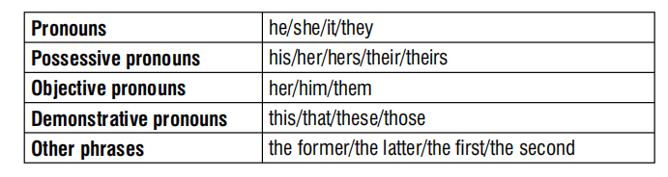
Examples of reference words and phrases

Slide 4
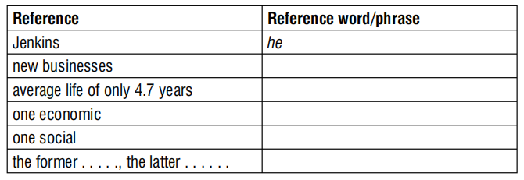
Read the following paragraph and complete the table
Jenkins (1987) has researched the life cycle of new businesses. He found that they have an average life of only 4.7 years. This is due to two main reasons; one economic and one social. The former appears to be a lack of capital, the latter a failure to carry out sufficient market research. Jenkins considers that together these account for approximately 70% of business failures.

Slide 5
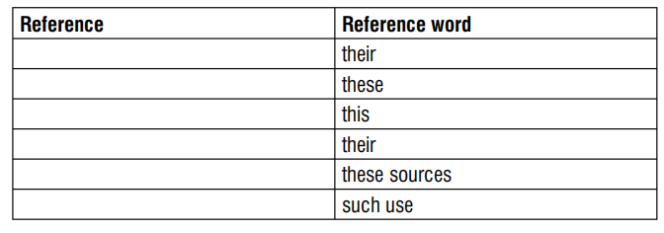
Read the paragraph and complete the table below to show what the reference words (in italics) refer to.
There is little prospect of improvement in the standard of living of the villagers from their present low level without the support of electricity. Presently, the households can enjoy only a limited number of hours of illumination based on kerosene or diesel. These are not cheap and so are not affordable by a large majority of the rural masses. This restricts the range as well as the intensity of their activities severely. But even if supply of power from these sources is available more abundantly, there is the problem of adverse environmental effects of such use.

Slide 6
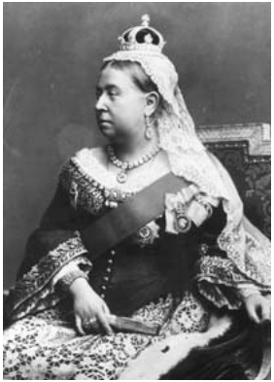
In the following paragraph, insert suitable reference words from the box below in the gaps
The Victoria and Albert Museum is in South Kensington in London. a) . . . . . . . is named after Queen Victoria and b) . . . . . . . husband, Prince Albert. c) . . . . . . . was made Queen in 1837, and married d) . . . . . . . three years later. e) . . . . . . . had a happy marriage which produced nine children. f) . . . . . . . . life together was quite simple, although g) . . . . . . . was the queen of the world’s most powerful nation. Albert had a serious character, and perhaps h) . . . . . . . major achievement was to organise the Great Exhibition of 1851, the profits from which helped to build the Museum.

Slide 7


Cohesion and coherence are the two important things considered while writing any content and are properties of written material considered in discourse analysis and text linguistics.
Coherence: A text makes sense to readers through the relevancy of theories, ideas and concepts.
Cohesion: The grammatical and lexical relationship in the text.
VS

Slide 8
